Slide 1
Early Detection of Alzheimer’s disease
Ramin Nourizadeh

Slide 2
Table of Contents
Introduction to Protein
Recent advances in protein design,
shifting from a physical-based function paradigm to one that uses deep learning
Discuss challenges to the design of marketable proteins with controllable properties.

Slide 3
Introduction
AD Stages
it has been established that SCD can occur at late stages of preclinical AD, before MCI is reached. This phase can be also referred to as pre-MCI or preprodromal AD.
probability of Aβ positivity of up to 0.75 for patients with MCI and of 0.60 for SCD subjects

Slide 4
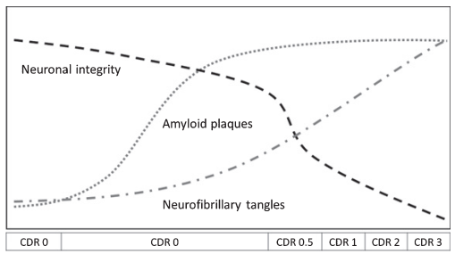
Introduction
AD diagnosis methods
biological markers, such as amyloid-beta (Aβ) protein accumulation, which is distinctive in AD, may be found in the brain up to 20 years before the stage of dementia

Slide 5
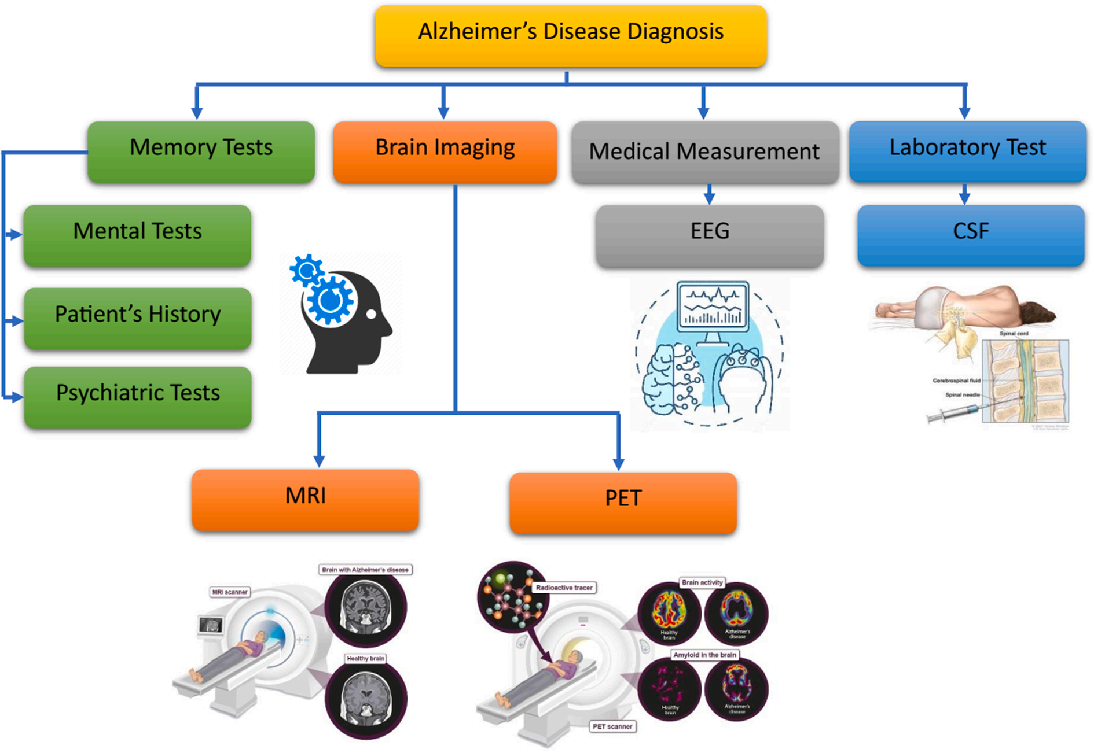
Introduction
AD diagnosis methods

Slide 6
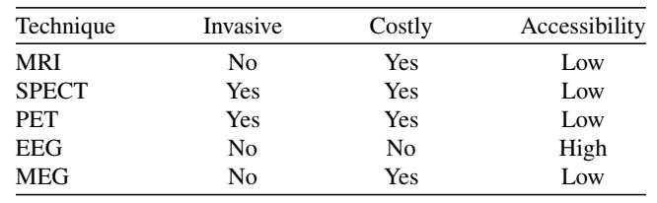
Introduction
AD diagnosis methods
Comparison of the medical techniques described in the Introduction section

Slide 7
Introduction
AD diagnosis methods
medical imaging techniques
images are typically segmented into voxels and features are extracted
EEG is processed in the time and the frequency domains.

Slide 8
Introduction
Dataset
More than 95% of the studies that focused on EEG-based classification were conducted with fewer than 100 participants.

Slide 9
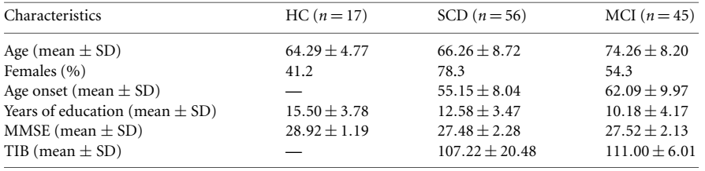
Introduction
Dataset
Clinical-demographic characteristics of population

Slide 10
Introduction
EEG
EEG changes related to AD progression into four main categories:
slowing,
complexity reduction,
synchronization decrement and
neuromodulatory deficit

Slide 11
Introduction
EEG
Electroencephalography signals (EEG) are a method of detecting electrical activity in the brain
changes can include increased slow brainwaves (delta and theta waves) [20] and decreased faster waves (alpha and beta waves)
an increased Theta/Alpha ratio has also been reported for subjects with mild AD
can be used to monitor changes in brain activity associated with the progression of the disease and help doctors adjust treatments and make better decisions.

Slide 12
Introduction
EEG Recording
EEG signal was recorded at 200 Hz
In a 10-min eye-closed resting state
Participants were required to remain awake during the entire recording
Standard 16-channels montage was utilized according to the 10–20 International System.

Slide 13
Introduction
Alzheimer
Patients with MCI and AD generally showed decreased alpha/beta power and increased theta/delta power in a broad range of brain regions such as frontal, temporal, parietal, and occipital areas

Slide 14
Introduction
Alzheimer
stated that 30% of people are misdiagnosed

Slide 15
Introduction
EEG Recording
EEG signal was recorded at 200 Hz
In a 10-min eye-closed resting state
Participants were required to remain awake during the entire recording
Standard 16-channels montage was utilized according to the 10–20 International System.
EEG can capture neural events in the order of milliseconds , but its spatial resolution is limited by the number of electrodes used to record the electrical activity of the brain.

Slide 16
Introduction
EEG Processing
A wavelet transform reveals important information in a signal’s time–frequency domain through analysis of frequency components.

Slide 17
Introduction
EEG Processing
Considering the complexity of EEG signals, classifier models should be reduced to more straightforward features that can be calculated.

Slide 18
Introduction
EEG Processing
four stages:
data acquisition,
signal denoising,
feature extraction,
classification.

Slide 19
Introduction
EEG Processing
The five frequency bands of B were defined as:
Delta: 0.5 – 4 Hz
Theta: 4 – 8 Hz
Alpha: 8 – 13 Hz
Beta: 13-25 Hz
Gamma: 25-45 Hz

Slide 20
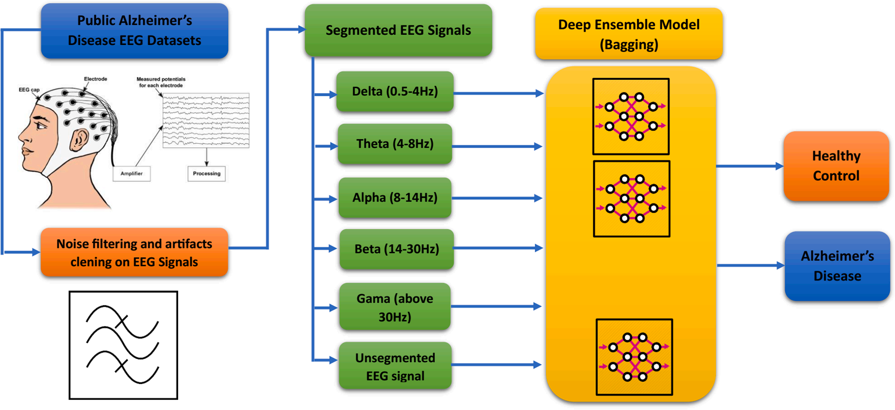
Introduction
EEG Processing
Block diagram AD diagnosis DEL model

Slide 21
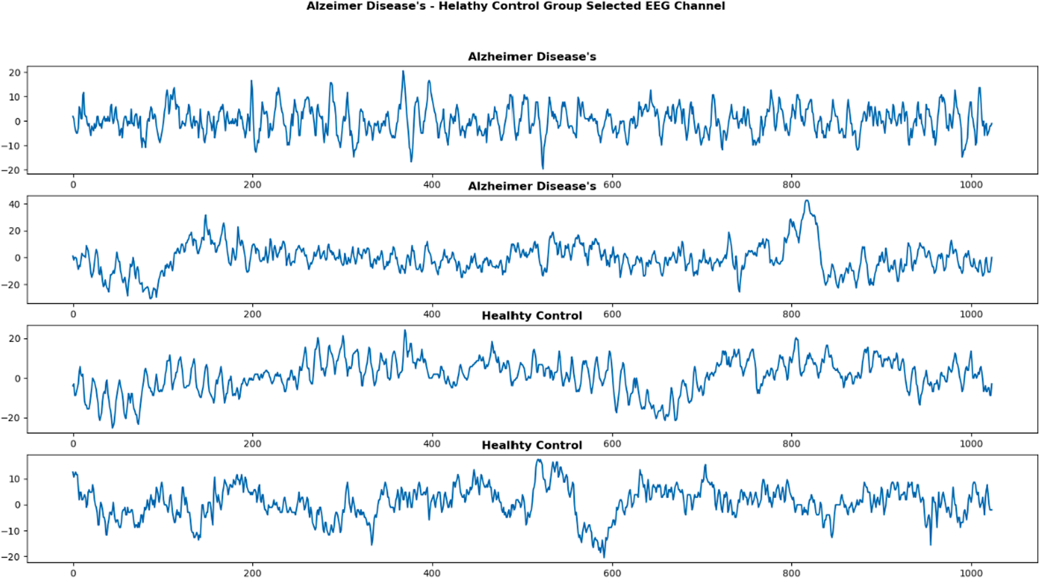
Introduction
EEG Processing
Alzheimer Disease’s (AD) – Healthy Control (HC) Group EEG signals.

Slide 22
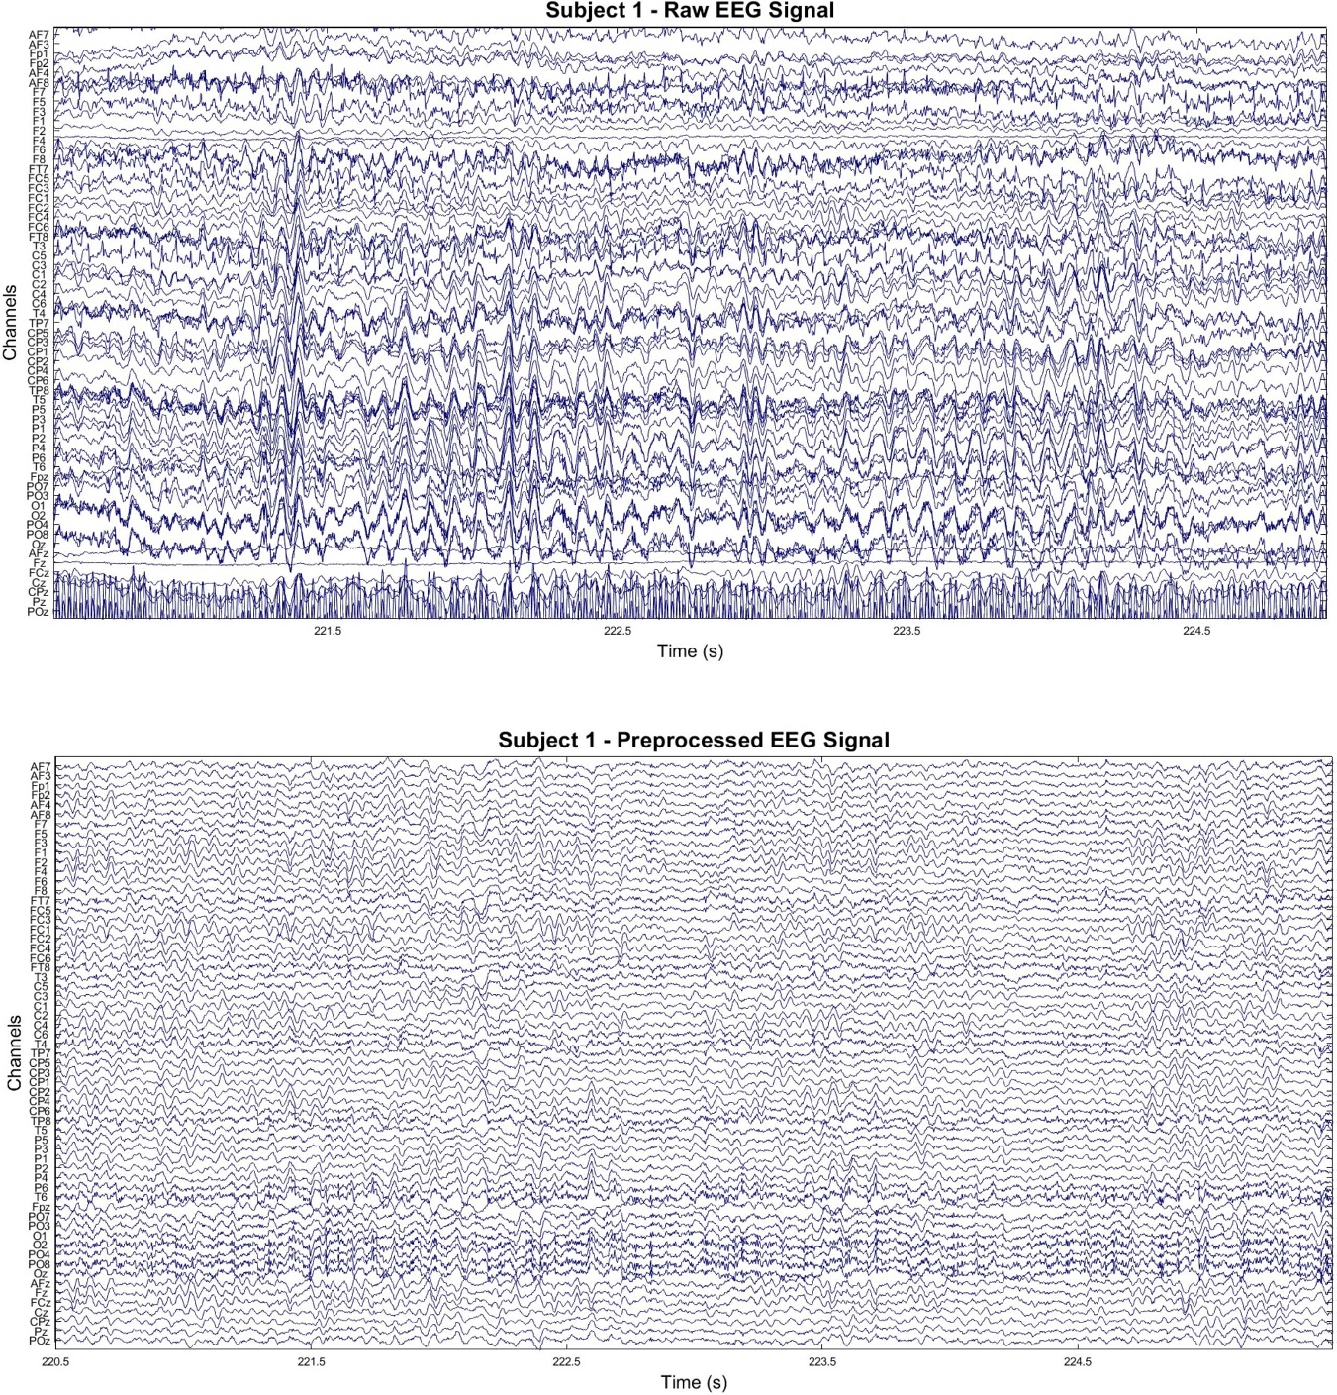
Introduction
EEG Processing
Sample EEG recordings of subject 1. (top) 5 s window of raw EEG signal. (bottom) Same window after preprocessing.

Slide 23
Introduction
EEG Feature Extraction
decompose it into other frequency bands, such as delta, theta, alpha, beta, and gamma
Each frequency band represents a diverse range of electrical activity in the brain
delta band :0.5-4 Hz, deep sleep and the maintenance of bodily functions
alpha band:8-13 Hz, attentional processes and relaxation

Slide 24
Introduction
EEG Feature Extraction
usually transformed to the frequency domain using
Fourier methodology such as Fast Fourier Transform (FFT)
Welch Power Spectral Density (PSD) analysis
transformed to the time-frequency domain using decomposition such as
Discrete Wavelet Transform (DWT)
Empirical Mode Decomposition (EMD)

Slide 25
Introduction
EEG Feature Extraction
After the transformation or analysis of EEG data with one of the following features are usually extracted to be fed to a Machine Learning framework for automatic detection, prediction, severity assessment, or evaluation of the given EEG task
abovementioned methodologies,
band power,
entropy,
fractal dimension, or
statistical

Slide 26
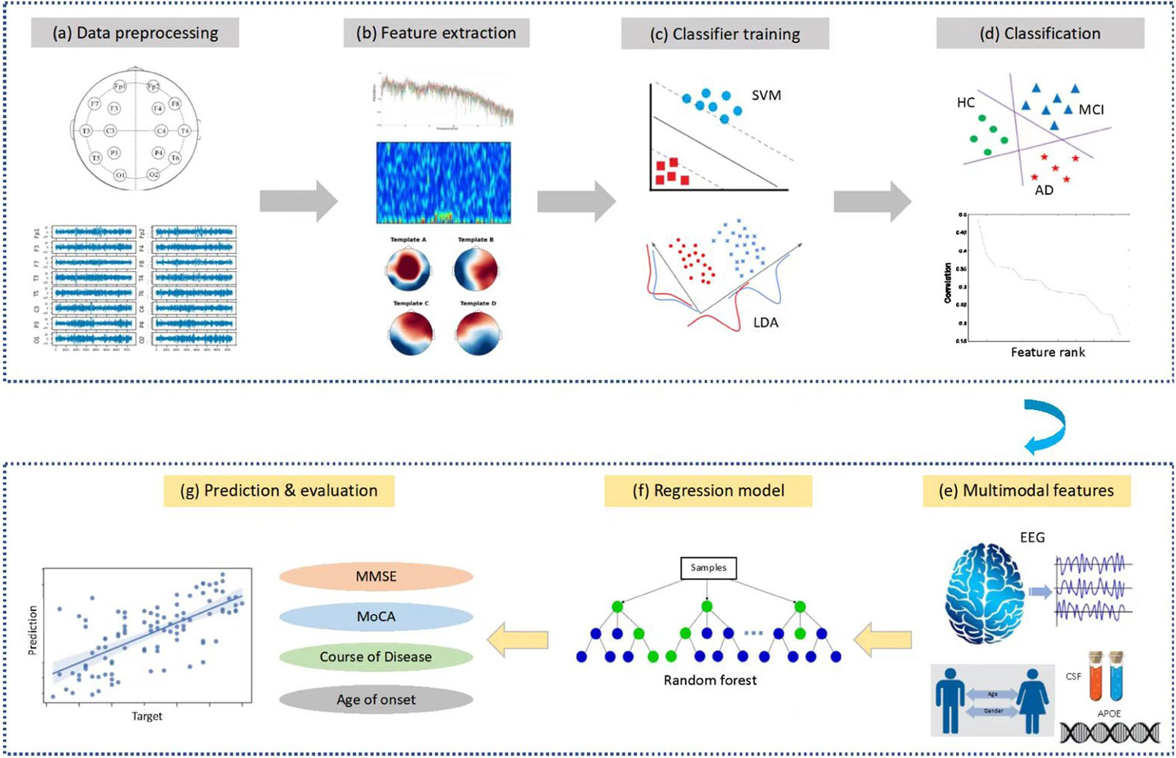
Methods
Overview
A total of 890 participants, including 189 patients with MCI, 330 patients with AD, 125 patients with other dementias and 246
Datasets are available from the corresponding author upon reasonable request
Jiao B, Li R, Zhou H, Qing K, Liu H, Pan H, et al. Neural biomarker diagnosis and prediction to mild cognitive impairment and Alzheimer’s disease using EEG technology. Alzheimer's Research & Therapy. 2023;15(1):32.

Slide 27
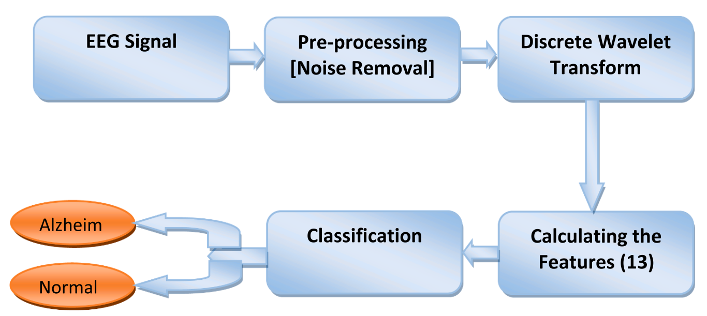
Methods
Three central lobe electrodes
This EEG dataset is available as open source.
The dataset contains 7 MCI, 59 AD, and 102 NC subjects
Highest performance of 96.55%
Fouad IA, El-Zahraa M. Labib F. Identification of Alzheimer’s disease from central lobe EEG signals utilizing machine learning and residual neural network. Biomedical Signal Processing and Control. 2023;86.

Slide 28
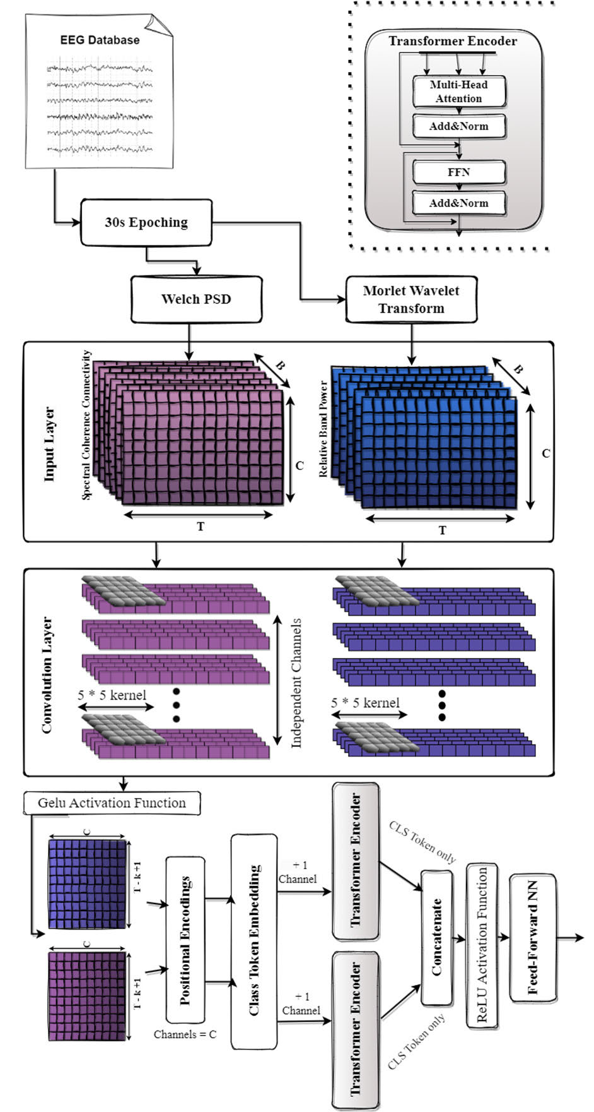
Methods
classification using a Dual-Input Convolution Encoder Network
: Recordings of 36 AD, 23 Frontotemporal dementia (FTD), and 29 age-matched healthy individuals (CN) were used
accuracy of 83.28% in the AD-CN problem using Leave-One-Subject-Out validation
Miltiadous A, Gionanidis E, Tzimourta KD, Giannakeas N, Tzallas AT. DICE-Net: A Novel Convolution-Transformer Architecture for Alzheimer Detection in EEG Signals. IEEE Access. 2023;11:71840-58.

Slide 29
Methods
First, each recording was divided into 30-second time windows with 15 seconds overlap to create the pool of EEG signals that will be used for the classification task. Next, the following two features have been extracted
Miltiadous A, Gionanidis E, Tzimourta KD, Giannakeas N, Tzallas AT. DICE-Net: A Novel Convolution-Transformer Architecture for Alzheimer Detection in EEG Signals. IEEE Access. 2023;11:71840-58.

Slide 30
Methods
extract two of the most promising biomarkers
Relative Band Power (RBP): increase in Theta/Alpha ratio in AD patients
Spectral Coherence Connectivity (SCC): decreased synchronization likelihood in AD patients
Miltiadous A, Gionanidis E, Tzimourta KD, Giannakeas N, Tzallas AT. DICE-Net: A Novel Convolution-Transformer Architecture for Alzheimer Detection in EEG Signals. IEEE Access. 2023;11:71840-58.

Slide 31
Methods
express them in image-like representations (3d matrixes)
fed in 2 parallel Convolution blocks
Miltiadous A, Gionanidis E, Tzimourta KD, Giannakeas N, Tzallas AT. DICE-Net: A Novel Convolution-Transformer Architecture for Alzheimer Detection in EEG Signals. IEEE Access. 2023;11:71840-58.

Slide 32
Methods
recordings from 88 participants
from Department of Neurology of AHEPA General University Hospital of Thessaloniki.
36 (13 males) of them were diagnosed with Alzheimer’s disease (AD group), 23 (14 males) were diagnosed with Frontotemporal Dementia (FTD group), and 29 (11 males) were healthy subjects (CN group)
Miltiadous A, Gionanidis E, Tzimourta KD, Giannakeas N, Tzallas AT. DICE-Net: A Novel Convolution-Transformer Architecture for Alzheimer Detection in EEG Signals. IEEE Access. 2023;11:71840-58.

Slide 33
Methods
The preprocessing pipeline of the EEG signals is as follows. First, a Butterworth band-pass filter 0.5-45 Hz was applied, and the signals were re-referenced to A1-A2. Then, the ASR routine [12] which is an automatic artifact reject method that can remove transient or large-amplitude artifacts
Miltiadous A, Gionanidis E, Tzimourta KD, Giannakeas N, Tzallas AT. DICE-Net: A Novel Convolution-Transformer Architecture for Alzheimer Detection in EEG Signals. IEEE Access. 2023;11:71840-58.

Slide 34
Methods
We made the dataset publicly available
Miltiadous A, Gionanidis E, Tzimourta KD, Giannakeas N, Tzallas AT. DICE-Net: A Novel Convolution-Transformer Architecture for Alzheimer Detection in EEG Signals. IEEE Access. 2023;11:71840-58.

Slide 35
Methods
This paper divides EEG signals into 5 frequency bands with a Butterworth band-pass filter. EEG signals recorded as 8 s in the datasets were segmented into 1 s epochs. An epoch was converted into a 2D array of 128x19. A total of 1120 epochs consist of two datasets combined. Then, EEG signals for each frequency band (delta, theta, alpha, beta, and gamma) were segmented into 1 s epochs (128x19 2D array) and given as input to ensemble learning
With 5 cross-fold training, the average accuracy of the DEL model reached 97.9% ± 1.1%.
Nour M, Senturk U, Polat K. A novel hybrid model in the diagnosis and classification of Alzheimer's disease using EEG signals: Deep ensemble learning (DEL) approach. Biomedical Signal Processing and Control. 2024;89.

Slide 36
Methods
Two datasets were used
We can send the datasets at the request of the authors
Nour M, Senturk U, Polat K. A novel hybrid model in the diagnosis and classification of Alzheimer's disease using EEG signals: Deep ensemble learning (DEL) approach. Biomedical Signal Processing and Control. 2024;89.

Slide 37
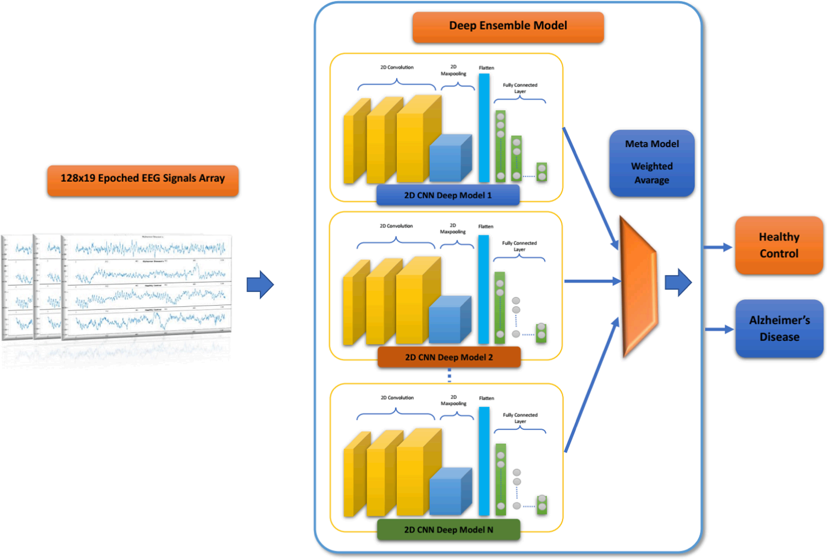
Methods
. The proposed Deep Ensemble Learning (DEL) Models for AD-HC Classification
Nour M, Senturk U, Polat K. A novel hybrid model in the diagnosis and classification of Alzheimer's disease using EEG signals: Deep ensemble learning (DEL) approach. Biomedical Signal Processing and Control. 2024;89.

Slide 38
Methods
Five different datasets were created by extracting delta, theta, alpha, beta and delta-to-theta frequency bands using bandpass filters.
delta dataset allowed our model to achieve the best performances for the discrimination of SCD and MCI, reaching an Area Under the ROC Curve (AUC) of 0.807
esults for the HC vs SCD vs MCI classification were obtained on alpha and theta with a micro-AUC higher than 0.74.
Sibilano E, Brunetti A, Buongiorno D, Lassi M, Grippo A, Bessi V, et al. An attention-based deep learning approach for the classification of subjective cognitive decline and mild cognitive impairment using resting-state EEG. Journal of Neural Engineering. 2023;20(1):016048.

Slide 39
Methods
Firstly, raw EEG signals are preprocessed
19 channels are selected and 4 frequency bands (δ, θ, α and β) are extracted
obtaining four distinct datasets and a fifth one using the δ-to-β range.
perform both two- and three-class classifications of epochs through LOSOCV.
Finally, a majority voting approach is used to label each subject in the test set either as HC, SCD or MCI based on the class assigned to its epochs.
Sibilano E, Brunetti A, Buongiorno D, Lassi M, Grippo A, Bessi V, et al. An attention-based deep learning approach for the classification of subjective cognitive decline and mild cognitive impairment using resting-state EEG. Journal of Neural Engineering. 2023;20(1):016048.

Slide 40
Methods
transformers
higher ability to deal with long-range dependencies
recognize patterns in sequences of data
more interpretable decision-making processes
recent efforts in exploring their applications on timeseries data, such as EEG or electromyography signals,are showing interesting results
Sibilano E, Brunetti A, Buongiorno D, Lassi M, Grippo A, Bessi V, et al. An attention-based deep learning approach for the classification of subjective cognitive decline and mild cognitive impairment using resting-state EEG. Journal of Neural Engineering. 2023;20(1):016048.

Slide 41
Methods
The electrodes were placed according to the 10–10 montage system and electrode-skin impedance was set below 5 kΩ. Subjects were sat in a reclined chair for approximately 20 min.
A cluster of 19 channels, namely Fp1, Fp2, F7, F3, Fz, F4, F8, T3, C3, Cz, C4, T4, T5, P3, Pz, P4, T6, O1, O2, was then selected. Since these channels evenly cover the scalp area, this EEG pattern is the most employed in the literature for similar studies [56] and has been proven to ensure sufficient quality along with possible comparison with previous rsEEG findings of other projects
Sibilano E, Brunetti A, Buongiorno D, Lassi M, Grippo A, Bessi V, et al. An attention-based deep learning approach for the classification of subjective cognitive decline and mild cognitive impairment using resting-state EEG. Journal of Neural Engineering. 2023;20(1):016048.

Slide 42
Methods
adding more spatial details by using all available 61 EEG channels, instead of a cluster of 19 channels, not only did not improve the performances of the model
Sibilano E, Brunetti A, Buongiorno D, Lassi M, Grippo A, Bessi V, et al. An attention-based deep learning approach for the classification of subjective cognitive decline and mild cognitive impairment using resting-state EEG. Journal of Neural Engineering. 2023;20(1):016048.

Slide 43
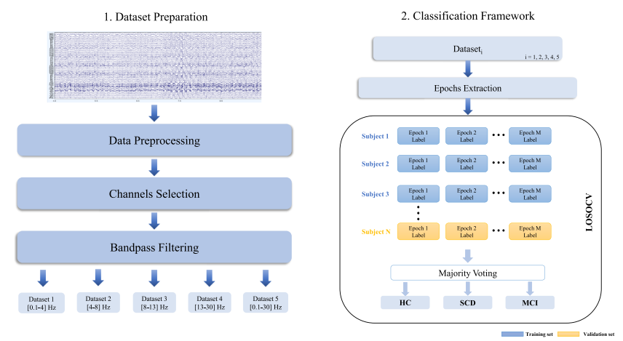
Methods
Workflow of the proposed method
Sibilano E, Brunetti A, Buongiorno D, Lassi M, Grippo A, Bessi V, et al. An attention-based deep learning approach for the classification of subjective cognitive decline and mild cognitive impairment using resting-state EEG. Journal of Neural Engineering. 2023;20(1):016048.

Slide 44
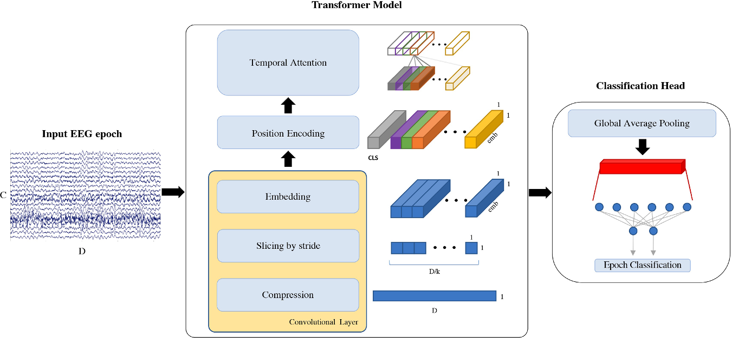
Methods
EEG epoch classification pipeline. Each EEG segment of C = 19 channels and D = 5120 datapoints is used as input to our model, which uses a convolutional layer to compress the signal, extract slices and embed the information. k = 31 is the size of the kernel, emb = 6 is the embeddings’ dimension and CLS is the classification token prepended to the input. Attention mechanism is then applied on the temporal domain and, after global average pooling, a linear layer is used to classify the input EEG epoch
Sibilano E, Brunetti A, Buongiorno D, Lassi M, Grippo A, Bessi V, et al. An attention-based deep learning approach for the classification of subjective cognitive decline and mild cognitive impairment using resting-state EEG. Journal of Neural Engineering. 2023;20(1):016048.

Slide 45
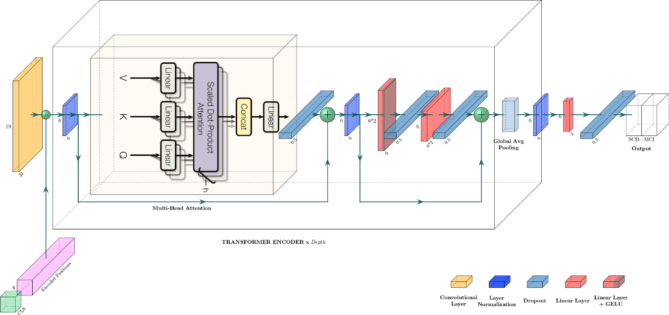
Methods
Proposed transformer architecture. CLS is the classification token, h = 3 is the number of heads used by multi-head attention and Depth = 2 indicates the number of times the transformer encoder block is repeated. A legend for uncaptioned blocks is provided on the bottom right corner
Sibilano E, Brunetti A, Buongiorno D, Lassi M, Grippo A, Bessi V, et al. An attention-based deep learning approach for the classification of subjective cognitive decline and mild cognitive impairment using resting-state EEG. Journal of Neural Engineering. 2023;20(1):016048.

Slide 46
Future Works
Evaluate the effectiveness of EEG techniques in diagnosing different types of dementias
Longitudinal studies to assess whether EEG biomarkers can be used to trace the progress trajectory of AD or evaluate the efficacy of pharmacological/therapeutic interventions for AD patients.
the model’s accuracy can be further improved using regularization techniques
interpretability

Slide 47
Future Works
other neurological disorders, such as Parkinson’s, epilepsy, and stroke, to diagnose and classify various diseases
In transformer model improvement of the proposed model, which could include the application of a spatial attention module on the EEG channels, is worth exploring

Slide 48
References
Molecular Biology, Not Only for Bioinformaticians. Istrail, 2013
From sequence to function through structure: Deep learning for protein design
NoeliaFerruz -2023

Slide 49
Thank You

